Slide 1
Amity Durham
NSW Department of Premier & Cabinet
3 November 2015 | NSW Innovation & Health Symposium
Notes:
Good morning, it’s a pleasure to be here.
I’m Amity Durham, Executive Director in the Social Policy Group at the Department of Premier and Cabinet. I look after the Family and Community Services policy area and a range of cross-government reform initiatives, including strategic commissioning and behavioural insights.
Today, I’m going to briefly talk about what social impact investing is and why the NSW Government is exploring opportunities in this area. I’ll then explain some our recent work to support a social impact investment market in Australia.

Slide 2
What is social impact investment?
Investments made into organisations and funds with the intent to generate social impact and financial return.
NOT-FOR-PROFITS
Access to capital to scale impact
BETTER COMMUNITY OUTCOMES
INVESTORS
‘Doing good’ and ‘doing well’
GOVERNMENTS
Direct funding to services that work

Slide 3
WHY SOCIAL IMPACT INVESTMENT?
Outcomes
Measuring and paying on outcomes
Prevention
Shifting spend away from high cost acute services to prevention
Innovation
Setting incentives and removing input controls on services
Partnerships
Sharing the risks and benefits across government and non-government sectors

Slide 4
HOW IT WORKS
Statistically reliable measure
Control
Control
Intervention
Intervention
Positive change
Treatment group needs to be large enough to be statistically reliable.
12 mth KPI measure
24 mth KPI measure
50-75 mths
End of Term
KPI measure
Performance payments linked to measurement of control and intervention groups.

Slide 5
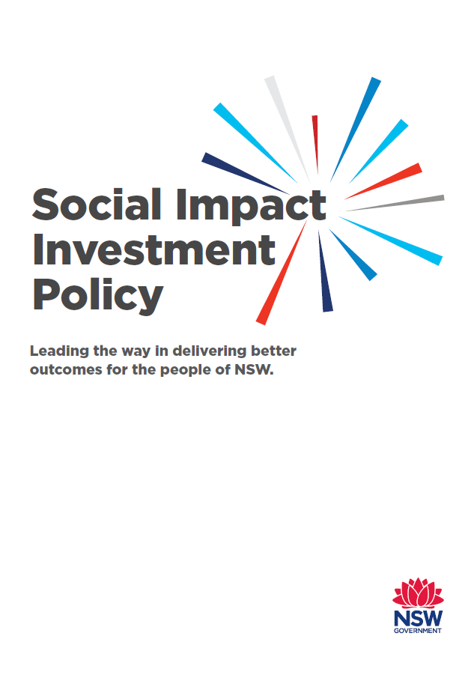
WHAT IS NSW GOVERNMENT DOING?
Social Benefit Bonds
UnitingCare Burnside

Slide 6
Contact us
Office of Social Impact Investment
(
*

+61 2 9228 5333
socialimpactinvestment@dpc.nsw.gov.au
dpc.nsw.gov.au/sii
@NSWOSII

