Slide 1
By Nickolas Yu, Program Manager - Staff wellness & Patient & Family-centred care. Sydney Local Health District.
Presentation for NSW Innovation and Health Symposium, November 2015

Slide 2
Acknowledge ...
Dr Teresa Anderson, SLHD CEO
Katharine Duffy, SLHD DONM
Karen Bowen & Rachel McBride, SLHD NM SLHD
Susan Pearce, Chief Nurse NSW
General Managers & Director’s of Nursing, NUMs & staff at participating sites Canterbury, Royal Prince Alfred, Concord, & Balmain Hospitals, & Tresillian.
Heart of Health Research Hub research collaborators: Dr Greg Fairbrother (SLHD), Dr Anya Johnson & Dr Helena Nguyen (Usyd), Prof Felicia Huppert & Dr Paul Atkins (ACU).
Cartoons illustrated by Simon Williams, designed by Nickolas Yu
2

Slide 3
TODAY’s PRESENTATION A consumer story How to support compassionate care Preliminary research findings

Slide 4
A CONSUMER STORY “By the book .. but not in the book.”

Slide 5
Notes:
A meta-analysis by Parks and Steelman (2008) found that in a range of studies, participation
in organizational wellness programs was linked to reduced stress levels, lower abenteeism,
higher job satisfaction and increased productivity. Previous research has also shown that
employee engagement contributes to key performance indicators, e.g. customer satisfaction,
productivity, profitability, employee turnover and sickness related absence (Harter, Schmidt
& Hayes, 2002).

Slide 6
HOW TO SUPPORT COMPASSIONATE CARE

Slide 7
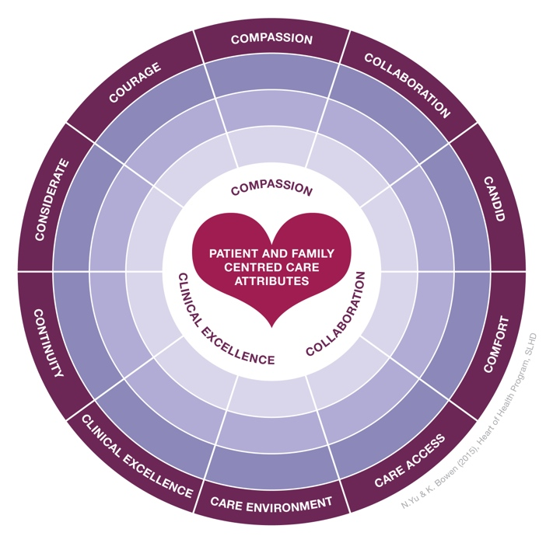
Patient & Family-centred Care Attributes

Slide 8
Compassion strategies
Experiential
Research &
Sound theory
Conversational & Reflective
Values
Narrative &
Creative
Role modelling & Leadership
Hard wiring
Meditation & Contemplative

Slide 9
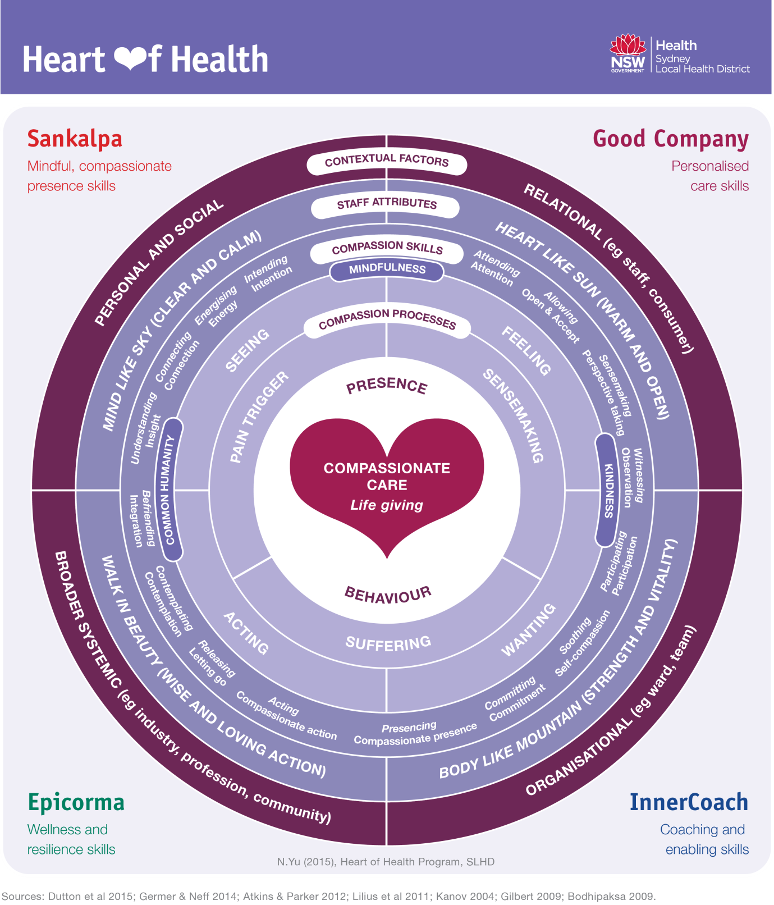

Slide 11
Mindful, compassionate
presence skills
Personalised
care skills
Compassionate,
Patient-centred
Respectful care
Wellness &
resilience skills
Coaching &
enabling skills
Support & specialised programs eg:
Compassion ‘Think tank’
Research collaboration

Slide 12
ABOUT THE PROGRAM

Slide 13
Meditation-based compassion and mindfulness training A form of mental & emotional fitness training
Science-based, Practical, Secular (non-religious)

Slide 14
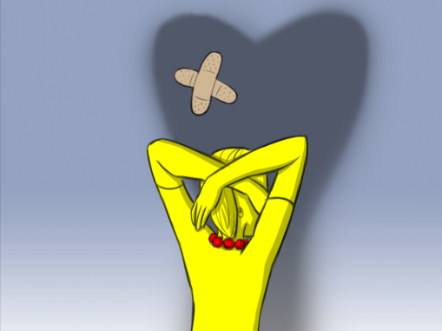
Compassionate care
Staff wellness
Happy worker – Productive worker hypothesis
eg Parks and Steelman (2008); Harter, Schmidt & Hayes (2002).
Notes:
A meta-analysis by Parks and Steelman (2008) found that in a range of studies, participation
in organizational wellness programs was linked to reduced stress levels, lower abenteeism,
higher job satisfaction and increased productivity. Previous research has also shown that
employee engagement contributes to key performance indicators, e.g. customer satisfaction,
productivity, profitability, employee turnover and sickness related absence (Harter, Schmidt
& Hayes, 2002).

Slide 15
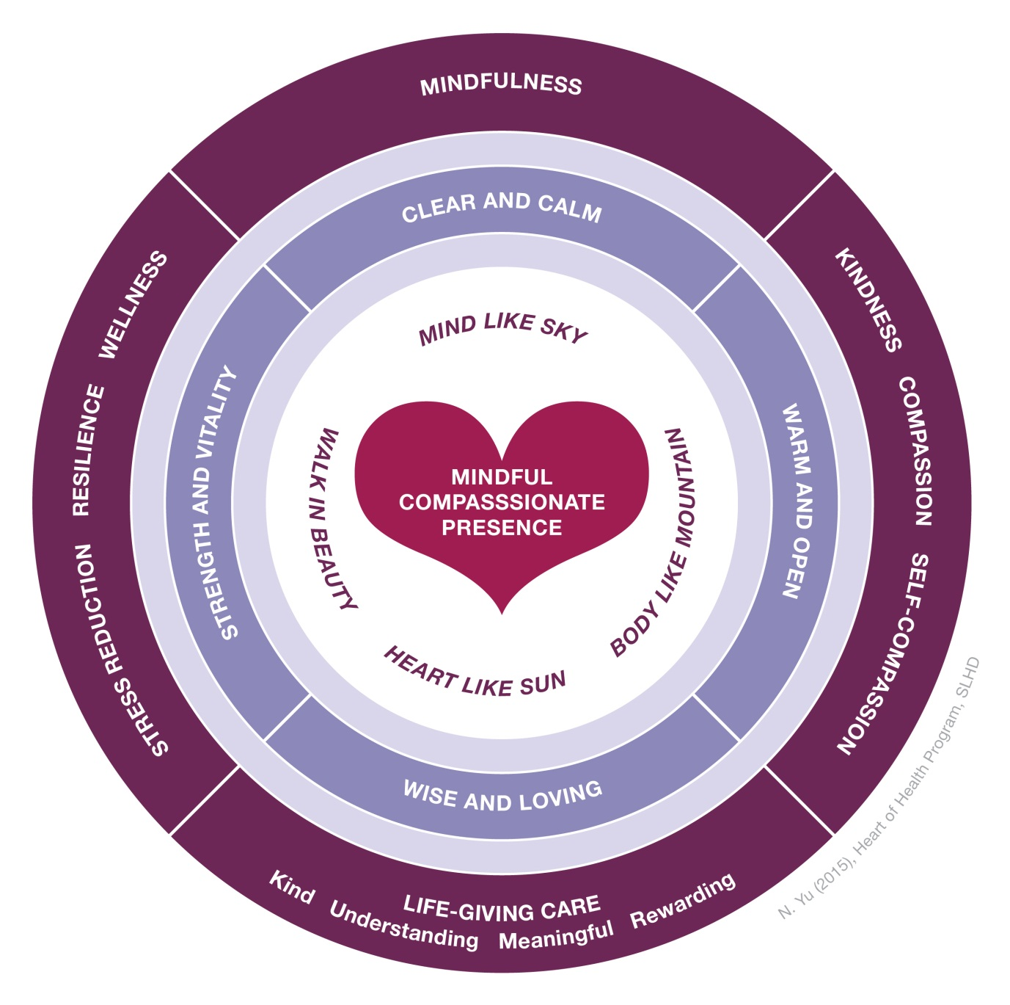
Deep relaxation meditation
Mindfulness meditation
Informal
(on-the-go) practices
Formal
(‘sitting’) practices
Kindness meditation
Self-compassion & Compassion meditation

Slide 17
PRELIMINARY RESEARCH FINDINGS

Slide 18
STUDY 1:
Cross sectional
STUDY 2:
Pre-post test (sustained)
STUDY 3:
Pre-post test (intensive)
Studies
(1-6)
Fairbrother*, Yu*,
Johnson, Nguyen,
& Wang (*SLHD &
Usyd Work & Org. Studies).
STUDY 4:
Non-randomised experiment
(waitlist design)
STUDY 5:
Qualitative
STUDY 6:
Qualitative – Sankalpa facilitators-in-training
Notes:
Study 1:
Evaluation of the effects of an evidence-based mindfulness, compassion meditation program (called Sankalpa) on participants’ wellness, mindfulness, and compassionate care.
Wave 1: Pre-post test. Wave 2: Waitlist control. Wave 3: RCT? Grant?? -
Study 2:
Measurement of compassionate and patient-centred care levels among nurses and midwives across the district.
Study 3:
Evaluation of the effects of the Compassionate, Patient & Family-centred, Relationship-based care (CPR) program on participants’ compassionate, patient-centred care and staff wellness.
Study 4:
Explore the experiences of participants in the Good Heart Program.

Slide 19
STUDY 1: What might a cross-sectional analysis of baseline survey-based self-report data indicate to us?

Slide 20
*Perspective-taking (r=0.58)
Demographics:
*Gender (NS)
*Years of service (NS)
*Positive affect
(r=0.52)
*Resources
available (r=0.33)
Independent variables measured
Intra-personal capacity:
*Mindfulness (r=0.31)
*Well-being (r=0.27)
*Flourishing (r=0.41)
*Self-compassion (r=0.38)
*Resilience (NS)
Workplace-specific:
*Core performance (r=0.27)
*Team performance (r=0.18)
*Job satisfaction (r=0.46)
*Compassionate climate (r=0.19)
Negative load:
*Stress (NS)
*Emotional labour (NS)
Dependent variable of interest:
*Compassionate Patient and Family-centred Care
NS = Not significant at P<0.05 level

Slide 21
Preliminary conclusion (n=130)
Perspective-taking capacity
Compassionate,
patient & family-centred care (CPFCC)
Positive emotions
After stepwise multiple regression … A model consisting of positive affect and perspective-taking yielded the best predictive model of CPFCC (adjusted r²=0.47)
So, improvements on positive affect and perspective-taking might positively impact on Compassionate, patient & family-centred care

Slide 22
STUDY 2: What is the impact of meditation-based mental & emotional fitness training (sustained dose) on staff wellness and compassionate care?

Slide 23
Preliminary results (n=24)
Perspective-taking capacity
Effect size: 0.5
Compassionate,
patient & family-centred care
Effect size: 0.8
Mindfulness
Effect size: 0.8
Climate of compassion
Effect size: 0.4
Stress
Effect size: 0.4
Emotional safety
Effect size: 0.3
At P<0.05

Slide 24
STUDY 3: What is the impact of meditation-based mental & emotional fitness training (intensive dose) on staff wellness and compassionate care?

Slide 25
Preliminary results (n=36)
Positive affect
Effect size: 1.3
Wellbeing
Effect size: 1.2
Mindfulness
Effect size: 1.7
Resources
Effect size: 1.0
Stress
Effect size: 1.0
At P<0.0001

Slide 26
“Very needed for our type of work dealing with all types of people in community – reminds us we need to look after ourselves to look after others …” RN ED
“Sankalpa helps me a lot to relax, refresh, and revive. I feel so happy to be part of this program. Thankyou NSW Health for organising this wonderful program for us.” RN Recovery
“The program allows me to take a moment and look after myself and to reflect on the things that I need to improve.” RN Oncology
“I look forward to Sankalpa. At first I liked the acknowledgment from my hospital – now I like the acknowledgement I have myself. It is nice to slow down, calm down, forgive and be kind to myself …” RN Oncology

Slide 27
Preliminary overall conclusion
Highly significant (P<0.0001) short-term Sankalpa effect shown among leaders during intensive format;
Significant (P<0.05) sustained Sankalpa effect shown among staff during sustained format;
Positive affect and perspective-taking shown to be important correlates of CPFCC
Empirical support for key program assumptions is emerging (eg PA & PTC)
Sankalpa appears to be an effective strategy for supporting compassionate, patient & family-centred care + staff wellness

Slide 28
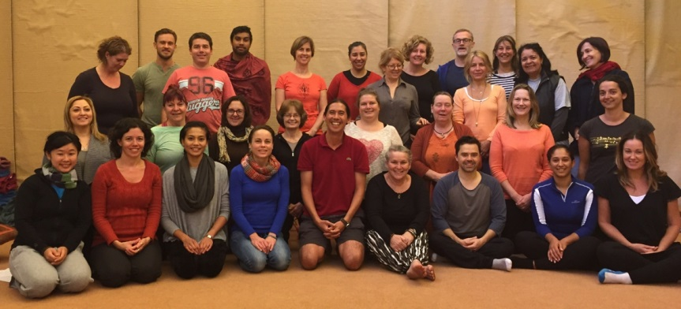

Slide 29
Appendices

Slide 30
Lindy Collins, NUM
Canterbury Emergency Dept.
*Impact
Clinical leader
Culture
*Key success factors

Slide 31
Staff wellness
Compassionate care
Relaxation & Stress relaxation, Mindfulness, Kindness, Self compassion, Compassion skills

Slide 32
What is compassion?
Definition
Latin: “to suffer with”
“a deep awareness of
the suffering of another
coupled with the wish
to relieve it.” Chochinov 2007
Elements of compassion
Head
(noticing + appraising)
… seeing
Heart
(emotional experience)
… feeling
Hands
(action to diminish suffering)
… acting
An understanding, a feeling, a motivational state, and an action.

Slide 33
SITUATIONAL MAP FOR COMPASSION IN CONTEMPORARY HEALTHCARE
Healthcare
Rising consumer expectations
Excellence
Risk management
Positive care
outcomes
(safe n sound)
Positive care
Experiences
(caring & responsive)
Bigger perspective on quality
Leaders’ vision
Patient &
Family-centred
care
$ effectiveness & funding models
Compassion
High performance cultures
MF, compassion, SR skills
(Attention & Emotional
Fitness training)
Happy worker-Productive worker
Humanistic/Sustainable cultures
Employee of choice, War for talent
Healthcare
A social good
Broader systemic influences
What else?

Slide 34
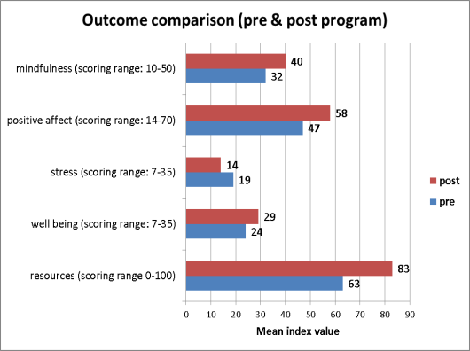
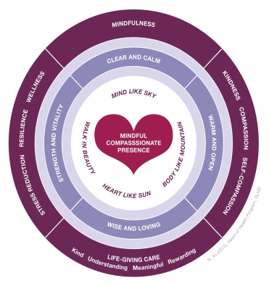
Intensive format science-based, meditation program (Sankalpa) improves positivity, stress, wellness, mindfulness: Preliminary results
Nickolas Yu¹, Greg Fairbrother ² Anya Johnson³, Helena Nguyen⁴
¹Program Manager Staff Wellness and Patient & Family-centred Care, Sydney Local Health District (SLHD), ²Clinical Nurse Consultant - Patient & Family-centred Care Research, SLHD
³⁻⁴University of Sydney Business School.
Nickolas Yu¹, Anya Johnson², & Helena Nguyen³
¹*Nickolas to add correct title and other collaborators**, ²⁻³University of Sydney Business School
Introduction
Patient & family-centred care is a key priority in modern healthcare.
Research has found that patient and family-centred care is characterised by collaboration, continuity of care, consideration of patient needs and preferences, comfort (physical and psychological), candid information sharing, courage, caring workplace environment, and compassion (Blewitt et al, 2015).
Compassion is “a deep awareness of the suffering of another coupled with the wish to relieve it.” (Chochinov 2007). Elements of compassion include understanding, appraisal, empathy, motivation and responding (Atkins & Parker 2012).
A number of studies have found that meditation training can increase compassion (Seppala et al, 2013; Fredrickson et al, 2008). Most of these programs run progressively over a 2 month period or more. Less is known about the effectiveness of compassion and mindfulness training delivered in a brief, intensive format.
Method
The Sankalpa Program consisted of five core
meditation practices:
mindfulness training,
relaxation and stress reduction training
kindness training,
self-compassion training,
compassion training.
The 2 day residential program comprised of 12 hours of compassion and mindfulness training.
36 clinical leaders (managers, educators and senior clinicians) participated in the program.
A within person repeated measures design was
used. A questionnaire was used to collect data at
two time points.
Pre/post data was analysed via SPSS using the paired-t test. Dependent variables canvassed were: Positive affect, Mindfulness, Stress, Well being & Resources (physical, mental, emotional). Gender and years in the profession were also measured as independent variables.
Results
Effect Sizes
Effect sizes were calculated for each of the five outcome variables of interest:
d=
Mindfulness 1.7
Positive affect 1.3
Stress 1.0
Well being 1.2
Resources 1.0
These values reflect strong effect sizes for the Sankalpa intervention.
Role of gender and years of professional service
Participants provided data on their gender and years of professional service. These two independent variables were assessed against change values on the five principal outcome measures.
Univariate analyses which sought to ascertain any mediating effect of gender (ANOVA) and years of professional service (Pearson Correlation), indicated that these variables did not significantly affect the change values on outcome. This result suggests the potentially broad applicability of the intervention.
Where to next?
Strengthen research design in next study by:
Using a cohort, wait-list control
Testing the longer term effects of the intervention.
Pre- training
Post- training
Contact
Nickolas Yu
Program Manager, Staff Wellness and Patient & Family-centred Care, Sydney Local Health District.
E: nickolas.yu@sswahs.nsw.gov.au
Note
This is a research project of the Heart of Health Research Hub which is a collaboration between academics and practitioners from Sydney Local Health District, University of Sydney and Australian Catholic University. The focus of research projects is staff wellness and compassionate care.
References
Atkins, P. & Parker, S. (2012). Understanding individual compassion in organisations: The role of appraisals and psychological flexibility. Academy of Management Review.
Blewitt L, Wang K, Nguyen H, Johnson A, Pidial K, Yu N (In press) Mindfulness: Creating the space for compassionate care. Industrial Org’l Psychology Review
Chochinov, H. (2012). Dignity therapy.
Fredrickson B, Cohn M, Coffey K, Pek J, Pinkel S (2008) Open hearts build lives: Positive emotions induced through loving-kindness meditation build consequential personal resources J Personality & Social Psychology 95(5): 1045
Seppala E, Rossomando T, Doty J (2013) Social connection and compassion: Important predictors of health and well being Social Research 80(2): 411-30
Sankalpa
T1=0
T2 = 3
Days
Aim
To investigate the impact of a 2-day meditation residential workshop on participants’ stress, wellness, positive affect and mindfulness.
Model
Mindfulness
Attention
Acceptance
Awareness
Present focus
Compassionate care
Compassion -behavioural
Sankalpa
Staff wellness
PANAS
DASS (Stress)
Mental wellbeing
Patient-centred care
Collaboration
Person first
Relationship-based

Slide 35
Impact of compassion
Compassionate individuals show ↑ helping behaviour, moral reasoning, connectedness & stronger interpersonal relationships, as well as ↓ depression, moodiness & mental illness (Cameron 2003)
Within org’s compassion influences and individual’s sensemaking about the org, resulting in ↑ org commitment, > frequent org citizenship, and ↑ quality relationships (Boyatzis et al 2013; Lilius et al 2012; Lilius et al 2008)
May use time & energy (Kanov et al 2004)
Receiving compassion
Manage pain (Lilius et al 2012), Supports change (Huy 2002), Express suffering & grieving (Hazen 2008), Legitimates suffering (Lilius et al 2012), Potential to trigger vulnerability, recovery & org reengagement, commitment, +ve r/ships, demonstrate supportive behaviours towards others (Dahl & O’Connor 2015)

Slide 36
Witnessing compassion
Elation (Haidt 2003; Lilius et al 2012), Promotes org virtuousness which may amplify org performance (Cameron et al 2004), Compassion satisfaction and positive prosocial identity (Grant et al 2008), Openness to receiving help from others, less stress (Cosley et al 2010), Work connectedness ... org commitment, lower turnover, org citizen (Lilius et al 2012)
Acknowledgement O’Connor* and Dahl (2015). *Heart of Health Research Hub

Slide 37
Compassion in defined in terms of four elements: compassionate noticing, appraising, feeling and acting (Atkins and Parker 2012)
Self/goal relevance or shared group belonging, deservingness and coping self-efficacy (Goetz et al. 2010)
If lack coping self-efficacy … aversive and anxiety provoking (Lazarus & Folkman, 1984).
Faced with such personal distress, the observer is more likely to act defensively rather than compassionately (Bandura, 1988).
Emotion regulation linked to compassion (Eisenberg et al., 1994); secure attachment is linked to compassion (Mikulincer, Shaver, Gillath, & Nitzberg, 2005).
An important aspect of coping self-efficacy appears to be the self-compassion
Notes:
Mindfulness involves open and nonjudgmental attending to present moment experience, self-kindness involves regarding oneself with warmth and care, rather than criticism (Neff, 2003) and common humanity involves a recognition that suffering is an aspect of human existence and is thus shared by all.
(HoH Research Hub Templeton application 2015).
Compassion at the heart of well-being in individuals and communities
Project Overview, Contributions
This research project will: a) help to develop best practice and evidence-based techniques for enhancing self-compassion, compassion towards others and wellbeing, particularly in hospitals, b) further explicate the relations between self-compassion and compassion towards others, and c) map the extent to which such interventions have the potential to “ripple-out” and influence large numbers of people through emotional contagion effects. These contributions target topics covered primarily in theme 2 (the emotional realm) and theme 3 (virtues, skills and well-being) of the Templeton Request for Proposals.
The project will begin with a multi-disciplinary examination of conceptual issues related to the social emotions, with a focus on compassion and how it can be differentiated from related concepts such as empathy, altruism, and kindness. The project members are drawn from psychology, religious studies, anthropology and philosophy and will contribute diverse perspectives on these issues.
The theory and models developed from this research will then be tested in an empirical study of health care professionals, a group known to experience very high levels of stress and burnout. Large groups of healthcare workers will be trained in the skills of self-compassion and compassion, using a randomized controlled trial design, to establish the effect of such training on their psychological well-being, as well as changes in workplace relationships and quality of patient care. A key feature of our approach to training is that it incorporates elements designed to increase focus upon compassion within the team and organizational culture. While interventions must start with individuals, they must also take into account the power of the social context to affect behavior.
We hypothesize that compassion training will increase well-being, quality of relationships, and perceived efficacy at work, and that improved relationships and work efficacy will further increase well-being in an upward spiral. Moving beyond the individual level of analysis, we will employ the techniques of social network analysis to examine how changes within individuals influence others beyond those who have been directly involved in the intervention. By incorporating multi-method approaches to the measurement of well-being and compassion (qualitative interviewing, self-report, peer-report, behavioral tests, social network analysis, and physiological measures), we will both obtain a deeper understanding of the pathways through which compassion is related to well-being, and contribute to advances in method and measurement in this field of research.
Part 1: Background
What is compassion and how might it be enhanced?
Compassion has been considered an aspect of wellbeing for at least 2500 years . The Buddha taught that compassion was an essential precursor of a skillful response to experience. Almost all the world’s religions include practices designed to cultivate compassion, in recognition of its role in enhancing individual and societal wellbeing. But people are more likely to extend compassion toward, and hence be willing to help, those to whom they feel more closely related (Cialdini, Brown, Lewis, Luce, & Neuberg, 1997) or to whom they have similar values, preferences, characteristics, or beliefs (Eisenberg & Miller, 1987). In an age of increasing social connectivity in our work and personal lives, we need more sophisticated and complex capacities to extend compassion to those with whom we share little.
The essence of compassion is “being moved by another’s suffering and wanting to help” (Lazarus, 1991: 289). The inclusion of responding, or actually helping the other, as a key element of compassion differentiates it from related concepts like empathy and aligns with contemporary functional views of emotion: “Emotions not only make us feel something, they make us feel like doing something” (Gross & Thompson, 2007: 5). From this perspective, compassion is not a single state, action, or feeling. Rather, it is a process involving both feeling and action.
Building upon process models of compassion, Atkins and Parker (2012) defined compassion in terms of four elements: compassionate noticing, appraising, feeling and acting. Previous models had paid insufficient attention to the process of appraisal of self and other in determining whether compassion occurs. Goetz et al. (2010) used empirical research to argue three primary appraisals are critical for the expression of compassion: self/goal relevance, deservingness and coping self-efficacy. A person will only act compassionately towards another if they view them as a) sharing similar goals or belonging to related groups; and b) deserving of compassion. We are less likely to extend compassion to someone who we see as distant to ourselves and/or who has brought their suffering upon themselves. In addition, in order for compassion to occur, the person must appraise that they can cope with being in the presence of another’s suffering. If a person makes an appraisal that the sufferer is self-relevant and deserving, but that they lack the resources or capabilities to manage their own emotions in the face of the other’s suffering, the observer is likely to experience the other’s suffering as aversive and anxiety provoking (Lazarus & Folkman, 1984). Faced with such personal distress, the observer is more likely to act defensively rather than compassionately (Bandura, 1988). Children and adults who can better regulate their emotions are more likely to feel compassion rather than distress in the presence of another’s suffering (Eisenberg et al., 1994) and those who are securely attached are more likely to experience compassion (Mikulincer, Shaver, Gillath, & Nitzberg, 2005). Building such ‘coping self-efficacy” (Roseman & Smith, 2001) is a key target for our intervention and a key reason why compassion enhances wellbeing.
One important aspect of coping self-efficacy appears to be the capacity to extend compassion towards the self. Neff’s model of self-compassion emphasizes three elements: mindfulness, self-kindness and common humanity. Mindfulness involves open and nonjudgmental attending to present moment experience, self-kindness involves regarding oneself with warmth and care, rather than criticism (Neff, 2003) and common humanity involves a recognition that suffering is an aspect of human existence and is thus shared by all. Building upon this work, and the work of Atkins and Parker (2012), this project will explore how mindfulness, values clarification and compassion-focused team development affect compassion through targeting improving noticing of suffering, more benevolent appraisals of self and other, more loving and connected feelings and a greater likelihood of acting in line with prosocial values in a hospital setting where compassion is a key part of effective performance.
How does compassion enhance wellbeing of self and others?
The aim of the Templeton grants is to enhance wellbeing. We see the development of self- and other-directed compassion as a key element of long-term, meaningful wellbeing. This is particularly true for healthcare workers. In recent years in organizational healthcare around the world, the patient and family-centred care (PFCC) movement has grown in both prominence and influence. PFCC is care which seeks a genuine intellectual, humanistic and practical partnership between the patient/family and the service provider/service providing organisation. Widely accepted subject dimensions of PFCC are i) respect, ii) emotional support, iii) physical comfort, iv) information and communication, v) continuity and transition, vi) care coordination, vii) involvement of family and carers, and viii) access to care (Luxford et al, 2010).
Simply put, the PFCC movement seeks better health provider-consumer partnerships. There is now a plethora of journal and web-based opinion and commentary in support of it, along with an increasing body of hard evidence which has linked a patient-provider partnership approach to clinical, cost and satisfaction outcomes (Luxford et al, 2010; Foot et al, 2014; WHO, 2015). The origins of the movement can be sourced to thought/sentiment arising from both healthcare professional groupings (clinical and organisational) and healthcare consumer/community groupings. Regardless of its provenance, its essential drive favours closer and more genuine/wholistic partnership relationships between providers and consumers. Compassion and compassionate care can be understood as central to progressing wider PFCC-related goals in healthcare, as without compassion (as felt/expressed by the clinician), partnered care along the eight PFCC dimensions noted above, may not be adequately progressed. Recent modelling of PFCC in the Australian context locates compassion both as a distinct PFCC operational domain and as a generalised driver of PFCC excellence across all domains (see Fig 1: Sydney Local Health District PFCC Attributes Framework).
Compassionate care is increasingly understood as a key defining feature of effective clinical and organizational performance today, particularly in the context of nursing, where an ‘attitudinal crisis’ around lack of concern and care has been recently described and related to patient neglect (Francis, 2013). For much of the 20th century until today, The profession of nursing has claimed ‘care’, a morally (rather than scientifically) defined concept, as its central domain of activity (Watson & Smith, 2002; Rafferty, 1996). Attitudinal breakdown in relation to this core unifying domain of nursing intent has been linked to job stressors such as high workload (Chang et al, 2007) and more recently to ‘compassion fatigue’ (Sabo, 2006). Differently to burnout, which might often arise from dissatisfaction with workplace arrangements/relationships, compassion fatigue represents a loss of capacity to care, which has resulted from sustained relational engagement with the pain and suffering of others (Najjar et al, 2009). Despite nursing’s longstanding mission to care ‘up close’ and ‘at the front line’ for their fellow humans’ trauma, illness and suffering, and the associated risk of compassion fatigue which such work must carry (particularly in the face of high workload), the profession has focused little attention on developing protective and restorative strategies for its members to wield, in the face of such risks. In recent years, mindfulness practices have emerged as potential-laden in this regard. Studies among health workers are now emerging in the literature, and some positive results have been demonstrated (Martin-Asuero and Garcia-Banda, 2010; Brooker et al, 2013; Foueur et al, 2013).
To the extent that compassion can be maintained in the face of high workloads and almost unlimited suffering, the wellbeing of patients obviously benefits. However, there is also growing evidence that feeling and expressing self and other directed compassion can enhance personal wellbeing for healthcare staff as well. We briefly summarize this evidence next.
Self-compassion enhances well-being
Numerous studies show high cross-sectional associations between measures of subjective well-being and measures of self-compassion (mainly using Neff’s Self-compassion Scale – SCS), as well as studies showing that change in self-compassion is associated with change in subjective well-being.
Self-compassion has been shown to be the active ingredient in the effect of MBC T on the prevention of depression relapse. Relapse was significantly less likely to recur in patients who had learned self-compassion compared with those whose self-compassion did not change (Kuyken et al., Behaviour Research & Therapy, 2010).
Increased self-compassion was associated with increased positive affect in experimental studies (Shapiro & Mongrain, Journal of Positive Psychology,2010)
Higher levels of self-compassion are correlated with lower levels of depression and anxiety (Neff, Hsieh and Dejitterat, 2005; Neff, Rude & Kirkpatrick, 2007), increased life satisfaction, greater feelings of social connectedness (Neff, Kirkpatrick & Rude, 2007) and positive affect (Neff et al, 2007).
Increased self-compassion was associated with increased motivation to change for the better (Breins & Chen, Personality and Social Psychology Bulletin, 2012).
Compassion towards others and well-being
Studies using loving-kindness meditation (e.g. Fredrickson et al., J Personality & Social Psychology, 2008; Shonin et al., Mindfulness, 2014) have shown that it results in:
increased positive affect
decreased negative affect and psychological distress
flexible thinking (multiple pathways to goal)
pleasurable anticipation of events
self-acceptance
increased purpose in life
positive relations with others
environmental mastery
increased social support received
reduction in illness symptoms
increased empathic accuracy
Fig 1: Sydney Local Health District Patient and Family-centred Care Attributes Framework
Central Questions of the Project
Building on this theoretical and empirical background, the central questions of this project are as follows:
To what extent does self-compassion and compassion training enhance wellbeing in self and others in a hospital setting?
To what extent are the effects of our intervention moderated by individual factors such as pre-existing levels of mindfulness, self-compassion and compassion, the extent to which participants regularly practice these skills?
What role do appraisals of self and others play in mediating the effects of training upon behavior and wellbeing?
How do the effects of compassion training ripple out to affect others in the social network of those who participate in the intervention?
How can we best measure compassion comprehensively and objectively?
Project Method
Stage 1: Exploring conceptual and measurement issues in compassion, elf-compassion and wellbeing from a multi-disciplinary perspective
The first stage in our project will involve a multi-disciplinary investigation of key conceptual issues including, focussing around how compassion is understood in Western and Asian (primarily Buddhist ) philosophical and religious traditions, e.g.
Is compassion as understood in Buddhism an emotion or does it include an element of motivation (the wish to take action to relieve another’s suffering )?
Is compassion regarded as an innate characteristic or a virtuous skill that can be learned and practiced ?
How compassion is differentiated from similar constructs, including empathy, altruism, kindness, pity, sympathy and generativity.
How the relationship between compassion and psychological well-being is conceived, e.g. is compassion necessary or sufficient for well-being? Does a high level of well-being increase the likelihood of compassion? Can compassion ever be detrimental to well-being?
How is the relationship understood between compassion towards others and compassion towards oneself?
While we already have interventions that have been shown to enhance compassion, self-compassion and wellbeing (see below), the results of this multi-disciplinary exploration will be used to inform the detailed design and implementation of these interventions. This phase will also inform our innovative approach to measures. Although we will make use of survey measures of compassionate care and wellbeing, these will not be exclusively self-report- peers and patients will also contribute to the data. Our approach to measuring compassionate care has already been developed and piloted. If we are successful in obtaining funding, we will use the results of our multi-disciplinary investigation to also develop a range of more objective and comprehensive measures including:
team level clinical indicators, absenteeism, turnover, patient satisfaction and experience, patient complaints,
behavioral measures of compassionate care
online behavioral simulation tasks to assess compassionate behavior in a controlled environment and outside the healthcare setting,
physiological measures such as stress reduction and heart rate variability
qualitative measures of critical incidents involving opportunities for compassion, enablers and barriers to compassion.
Stage 2: Conducting a randomized controlled trial of an intervention to enhance compassion, self-compassion and wellbeing.
Participants
Sydney Local Area Health District will be the location for this phase of the project. This health district which serves central and inner-western Sydney, is inclusive of two large tertiary referral hospitals, two smaller community based hospitals and an extensive community-based care infrastructure. It employs over 10,000 staff directly or indirectly involved in providing care to patients.
The sample will involve approximately 240 participants drawn from 24 wards randomly allocated to each of the two conditions (n= 120 in each condition): a) a compassion enhancement intervention targeting both individual and collective compassion; b) a waitlist control group matched as closely as possible on type of ward (medical, surgical, emergency) and medical specialty (oncology, neurology etc.).
We will also be collecting data regarding compassion, wellbeing and compassionate care from peers, patients and managers not directly involved in the intervention. We will then conduct social network analyses to explore the extent to which the interventions affect compassion and wellbeing through contagion effects (citation needed).
The compassion-focused intervention
The compassion-focused intervention will consist of a combination of compassion-focused meditation training and team development. While both these elements will be combined in the intervention for this research, we now describe each in turn.
The meditation program has already been piloted across four hospitals, involving more than 100 staff, in the Sydney Local Health District, Australia. Participants learn and practise relaxation, mindfulness, compassion and self-compassion skills. The program consists of weekly one hour workshops spread across 12 months, with staff attending whenever they can, taking into account clinical demands and rotating 24 hour work rosters. During training, participants will practice mindfulness, self-compassion and loving-kindness meditations. There will also be group discussion of the nature of compassionate care and barriers to its implementation.
Critically for the purposes of this application, Atkins and Parker (2012) proposed that levels of compassion in organizations would be moderated by team and organizational culture. Concurrently with the meditation program, participants in the experimental condition will participate in a compassion-focused team development program. This program will be an adaptation of the “ProSocial Intervention” aimed at increasing co-operation in groups which has already been piloted in more than 20 organizations internationally (Wilson, Ostrom and Cox, 2013; see also www.prosocialgroups.org). Intact teams will be led through experiential exercises and discussion exploring the key principles of the prosocial approach, with a particular focus upon overcoming team and organizational level barriers to expressing compassionate care.
Timeline
Stage 1 of the project will begin immediately if we are fortunate enough to have our project funded. Initial work would inform the measures we use in our empirical study. Some questions in Part 1 would continue to be examined in parallel with the empirical study. Piloting for the Heart of Health project is currently underway, and will be completed by the time successful projects are due to start. The mindfulness/compassion training will be poised to begin three months into the project. The additional team development program will be ready to follow on. Thus, pre-and post-intervention measures will be collected X months into the project, allowing for 6-12 month follow-up, data analysis and the drafting of journal articles.
Research team
The research team will draw upon numerous disciplines including psychology (social, organisational, clinical, positive psychology, psychometrics), philosophy (virtue ethics, comparative eastern versus Western approaches), Buddhist scholarship, including the anthropology of Buddhist societies, and nursing (senior research nurses). The majority of the team are based in the Institute for Positive Psychology and Education at the Australian Catholic University in Sydney, Australia, with our members of the research theme “Mindfulness, compassion and action”. Detailed CV’s for each member of the team are attached separately.
Budget
This is an ambitious, integrative project which will require funding at the highest level that is available for this RFP. Therefore we request $310,000 over two years to fund the project.
REFERENCES
Atkins, P. W. B., & Parker, S. K. (2012). Understanding individual compassion in organizations: the role of appraisals and psychological flexibility. Academy of Management Review, 37(4), 524-546.
Bandura, A. (1988). Self-efficacy conception of anxiety. Anxiety Research, 1(2), 77-98. doi:10.1080/10615808808248222
Brooker, J., Julian, J., Webber, L., Chan, J., Shawyer, F., Meadows, G. (2013). Evaluation of an occupational mindfulness program for staff employed in the disability sector in Australia. Mindfulness, 4(2), 122-136
Chang, E., Bidwell, J., Huntington, A., Daly, J., Johnson, A., Wilson, H., Lambert, V., Lambert, C. (2007). A survey of role stress, coping and health in Australian and New Zealand hospital nurses. International Journal of Nursing Studies 44, 1354-1362
Cialdini, R. B., Brown, S. L., Lewis, B. P., Luce, C., & Neuberg, S. L. (1997). Reinterpreting the empathy–altruism relationship: When one into one equals oneness. Journal of Personality and Social Psychology, 73(3), 481-494. doi:10.1037/0022-3514.73.3.481
Eisenberg, N., Fabes, R. A., Murphy, B., Karbon, M., Maszk, P., Smith, M., . . . Suh, K. (1994). The Relations of Emotionality and Regulation to Dispositional and Situational Empathy-Related Responding. Journal of Personality and Social Psychology, 66(4), 776-797. Retrieved from <Go to ISI>://A1994NE23800015
Eisenberg, N., & Miller, P. A. (1987). The relation of empathy to prosocial and related behaviors. Psychol Bull, 101(1), 91-119. Retrieved from http://ovidsp.ovid.com/ovidweb.cgi?T=JS&NEWS=N&PAGE=fulltext&D=psyc3&AN=1987-15523-001
Foot C, Gilburt H, Dunn P, Jabbal J et al (2014) People in control of their own health and care: The state of involvement The Kings Fund in association with National Voices, London
Foureur, M., Besley, K., Burton, G., Yu, N., Crisp, J. (2013). Enhancing the resilience of nurses and midwives: pilot of a mindfulness based program for increased health, sense of coherence and decreased depression, anxiety and stress. Contemporary
Nurse, 45(1), 114-125.
Francis R (2013) The Mid Staffordshire NHS Foundation Trust Public Inquiry – Chaired by Robert Francis QC. http://www.midstaffspublicinquiry.com/report
Gist, M. E., & Mitchell, T. R. (1992). Self-Efficacy: A Theoretical Analysis of Its Determinants and Malleability. Academy of Management Review, 17(2), 183-211. Retrieved from <Go to ISI>://A1992HQ22000001
Goetz, J., Keltner, D., & Simon-Thomas, E. (2010). Compassion: An Evolutionary Analysis and Empirical Review. Psychol Bull, 136(3), 351. Retrieved from http://proquest.umi.com/pqdweb?did=2035765981&Fmt=7&clientId=20870&RQT=309&VName=PQD
Gross, J. J., & Thompson, R. A. (2007). Emotion Regulation: Conceptual Foundations. In J. J. Gross (Ed.), Handbook of emotion regulation (pp. 3-24). New York, NY: Guilford Press; US.
Lazarus, R. S. (1991). Emotion and adaptation. New York, NY: Oxford University Press.
Lazarus, R. S., & Folkman, S. (1984). Stress, appraisal and coping. New York: Springer.
Luxford K, Piper D, Dunbar N, Poole N for The Australian Commission on Safety and Quality in Health Care (2010) Patient-centred care: Improving quality and safety by focusing care on patients and consumers ACSQHC Discussion Paper, Sydney
Martin-Asuero, A., Garcia-Banda, G. (2010). The mindfulness–based stress reduction program reduces stress-related psychological distress in health care professionals. The Spanish Journal of Psychology, 13(2), 897-905.
Mikulincer, M., Shaver, P. R., Gillath, O., & Nitzberg, R. A. (2005). Attachment, caregiving, and altruism: Boosting attachment security increases compassion and helping. Journal of Personality and Social Psychology, 89(5), 817-839. doi:Doi 10.1037/0022-3514.89.5.817
Najjar, N., Davis, L.W., Beck-Coon, K., & Doebbeling, C.C. (2009). Compassion fatigue: A review of the research to date and relevance to cancer-care providers. Journal of Health Psychology, 14(2), 267-277.
Neff, K. D. (2003). Self-Compassion: An Alternative Conceptualization of a Healthy Attitude Toward Oneself. Self and Identity, 2(2), 85-101.
Neff, K. D., Hsieh, Y.-P., & Dejitterat, K. (2005). Self-compassion, Achievement Goals, and Coping with Academic Failure. Self and Identity, 4(3), 263-287.
Neff, K. D., Kirkpatrick, K. L., & Rude, S. S. (2007). Self-compassion and adaptive psychological functioning. Journal of Research in Personality, 41(1), 139-154.
Neff, K. D., Rude, S. S., & Kirkpatrick, K. L. (2007). An examination of self-compassion in relation to positive psychological functioning and personality traits. Journal of Research in Personality, 41(4), 908-916.
Rafferty A (1996) The politics of nursing knowledge Routledge London
Roseman, I. J., & Smith, C. A. (2001). Appraisal theory: Overview, assumptions, varieties, controversies. In K. Scherer & T. Johnstone (Eds.), Appraisal processes in emotion: Theory, methods, research (pp. 3- 19). New York, NY: Oxford University Press.
Sabo, B.M. (2006). Compassion fatigue and nursing work: Can we accurately capture the consequences of caring work? International Journal of Nursing Practice, 12(3), 136-142.
Watson J, Smith M (2002) Caring science and the science of unitary human beings: a trans-theoretical discourse for nursing knowledge development Journal of Advanced Nursing 37(5): 452-61
Wilson, D. S., Ostrom, E., & Cox, M. E. (2013). Generalizing the core design principles for the efficacy of groups. Journal of Economic Behavior & Organization, 90, Supplement(0), S21-S32. doi:http://dx.doi.org/10.1016/j.jebo.2012.12.010
World Health Organisation (2015) WHO global strategy on people-centred and integrated health services Interim Report WHO, Service Delivery & Safety, Geneva
Yu N & Bowen K (2015) Sydney Local Health District Patient and Family-centred Care Attributes Framework. SLHD, Sydney
Maybe better to avoid false precision (‘2600 years’), especially since most scholarly dates for the Buddha now put him around 450-400 CE. This is a pretty Western reading of what ‘the Buddha taught’ but probably it is what is wanted here.
This section in particular needs work I think. What is the best evidence that compassion enhances wellbeing?
I think better to avoid ‘West’ versus ‘East’. As far as I know we’re only talking about Buddhism, so I have specified this, though we certainly could look at other religious and philosophical traditions.
I’m a bit uncomfortable about this, since it treats ‘emotion’ as a universally valid category. In reality the Buddhist categories do not map at all well onto ‘emotion’ and other Western psychological terminology, despite some recent attempts to equate them. But I don’t want to be too picky here.
I th
I assume that all five bullet points here should follow from the “e.g.” so I have restructured accordingly.
Note that this only has to be one line.

