Slide 1
Professor Afaf Girgis
​Psycho-oncology Research Group
Centre for Oncology Education and Research Translation
Ingham Institute for Applied Medical Research, UNSW Medicine

Slide 2
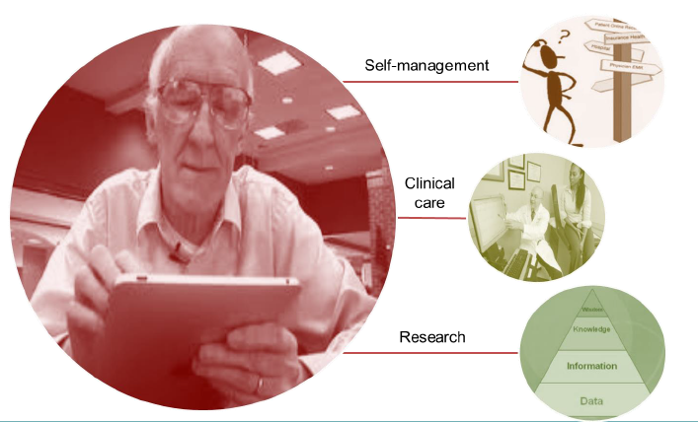
Funding: Cancer Institute NSW & Bupa Health Foundation
Governance: SWSLHD, ISLHD, CINSW, cross-LHD Advisory Groups
An integrated eHealth platform, using patient reported outcomes (PROs) to enable cancer survivors to achieve and maintain improved health and wellbeing and better cancer outcomes.
15+ years of evidence, now being translated into practice, clear agenda of both research and integrated service improvement

Slide 3
System-level benefits of PROMPT-Care
PROs integrated with hospital’s EMR
Systematic data collection during & post-treatment; triggers
Longitudinal and outcome data for all patients, not just research
Patient-centred clinical care: automated PRO scoring; real-time clinician feedback; treatment and referral pathways; reports accessible by all team members
Patient self-management and shared care with GPs – fulfilling patients’ needs without necessarily using finite specialist resources
In future: improved knowledge about CALD issues; access for CALD patients

